Slide 1




(21CC505PC) SOFTWARE ENGINEERING
UPPAL CAMPUS
NARAYANGUDA
IBRAHIMPATNAM
UNIT – 2
GIT AND GITHUB
TOPIC -7
BASIC GIT COMMANDS - VERSION, CONFIG, INIT, STATUS, ADD, COMMIT, DIFF, HELP
BY
B MADHURIKA(Ph.D.)
Assistant Professor
CSE

Slide 2

SOFTWARE ENGINEERING
(21CC502PC)
BY
MADHURIKA BUDARAJU
ASSISTANT PROFESSOR
CSE
KMIT

Slide 3
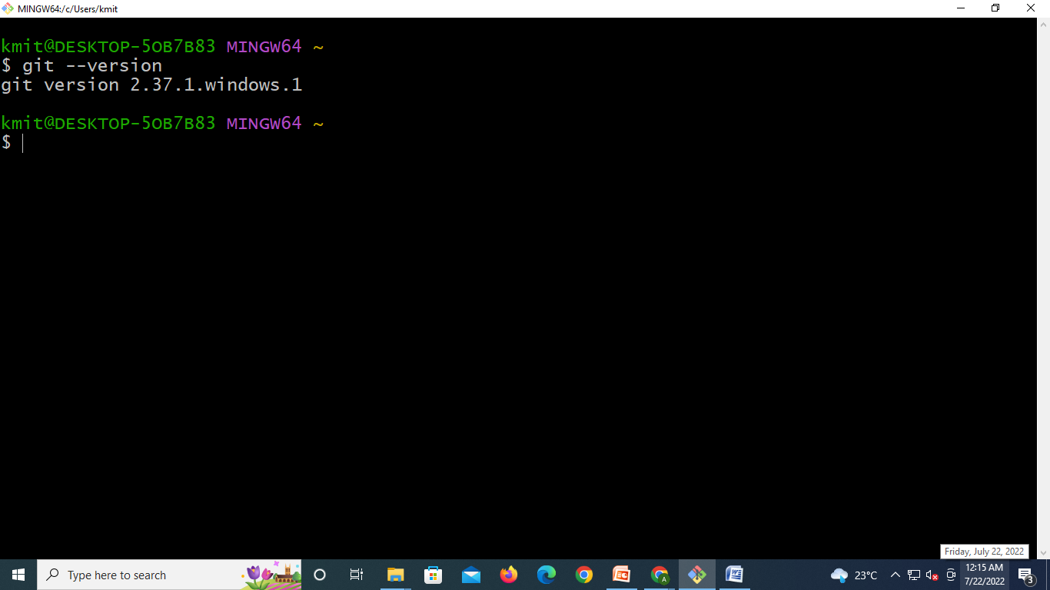
Git Basics
Git Version: Check if Git is installed using git --version.

Slide 4
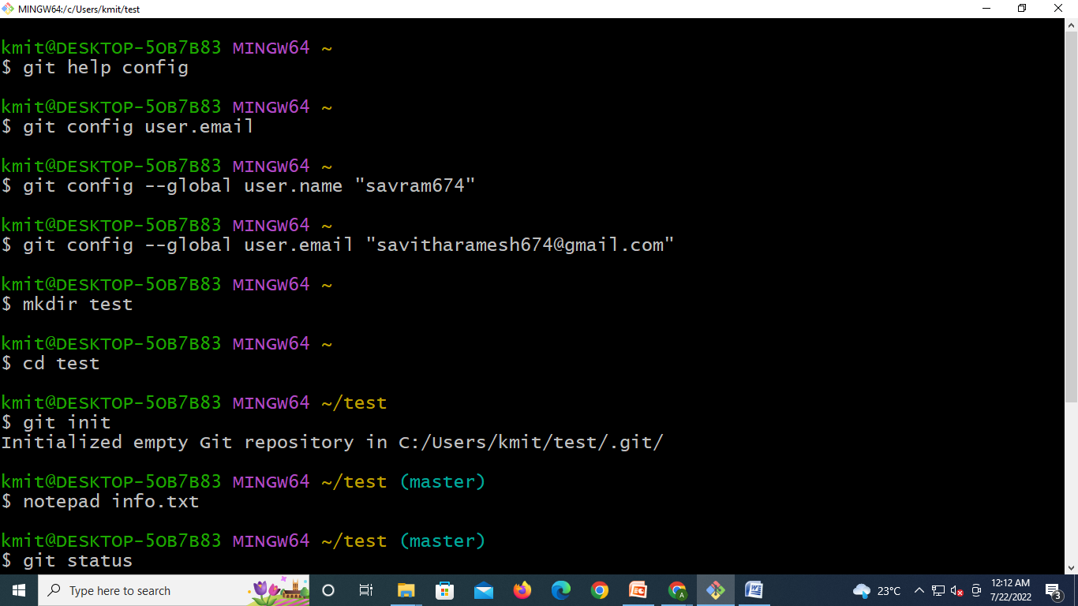
Git Basics
Git Config: Set up your name and email using git config.
Essential for setting up your user name and email, ensuring that every commit you make is associated with the correct identity in the project history.
Example:
git config --global user.name "Your Name“
git config --global user.email "your.email@example.com"

Slide 5

Git Basics
Git Init: Start a new project by creating a Git repository.
Example: git init creates an empty Git project.

Slide 6
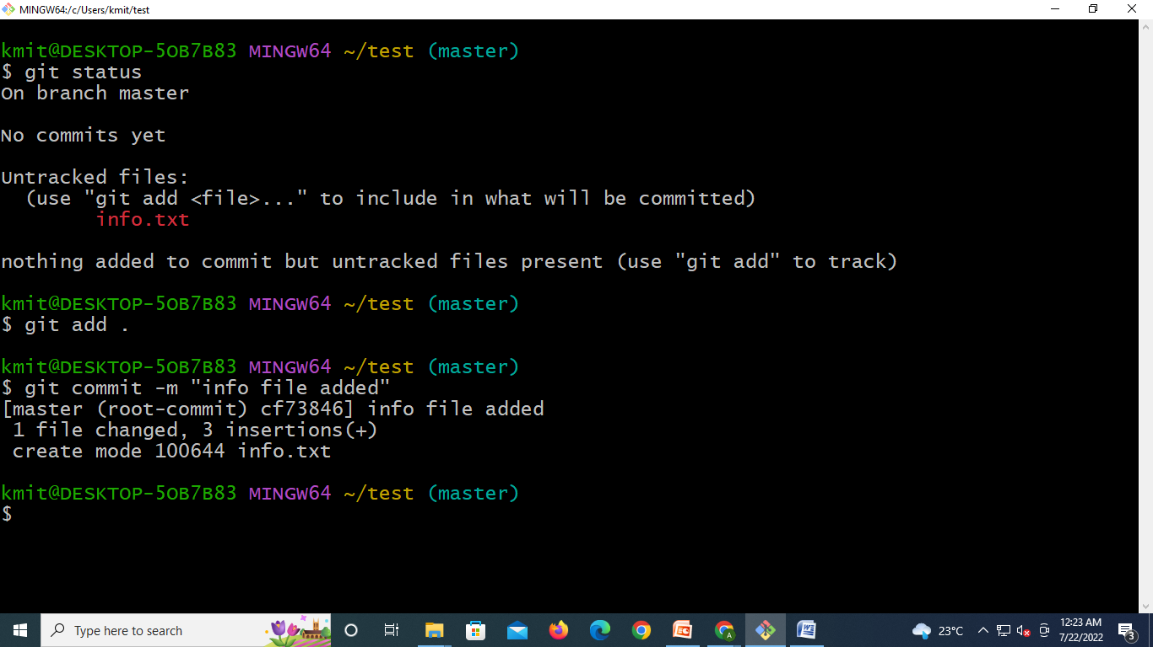
Git Basics
Git Status: Check the current state of your files and see if any changes need to be saved.
Command: git status
Example: Running git status tells you if there are files to be staged or committed.

Slide 7
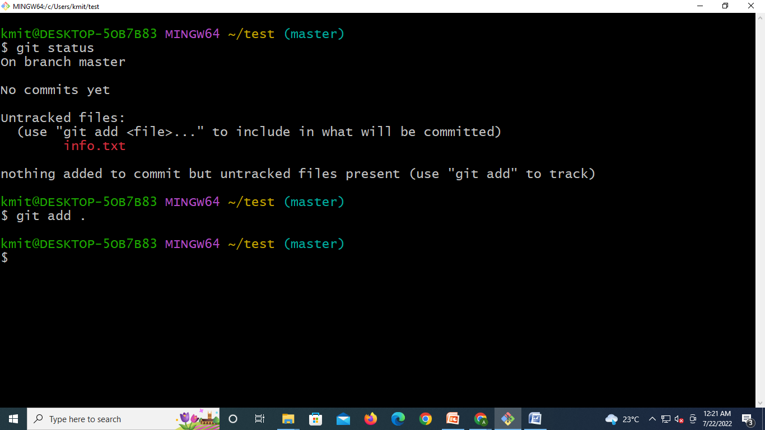
Git Basics
Git Add: Stage changes by adding files to the staging area before saving.
Example: git add . stages all changes.

Slide 8

Git Basics
Git Commit: Save your changes with a message explaining what was changed.
Example: git commit -m "Added new feature"

Slide 9
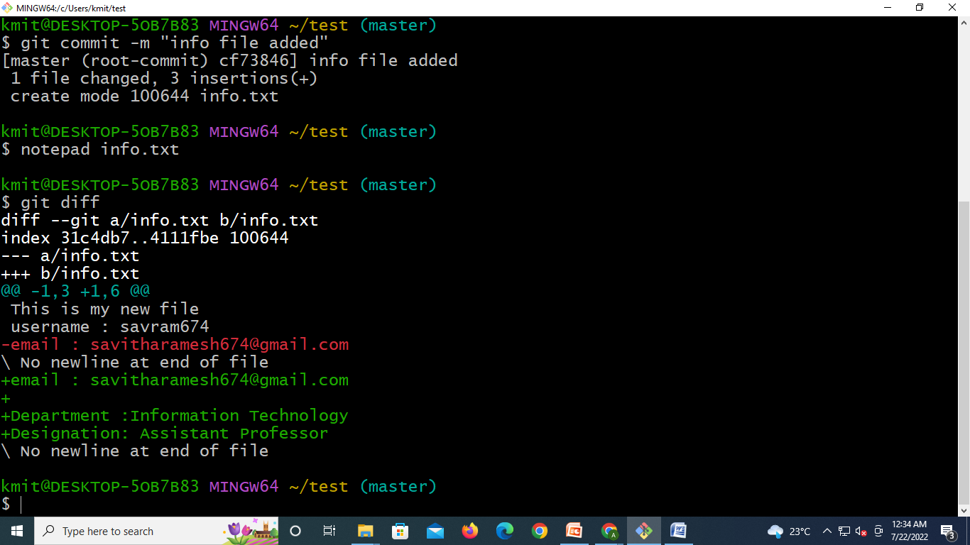
Git Basics
Git Diff: Compare changes between your current files and the last commit.
Command: git diff
Example: Run git diff to see the differences between your current work and the last saved version.

Slide 10
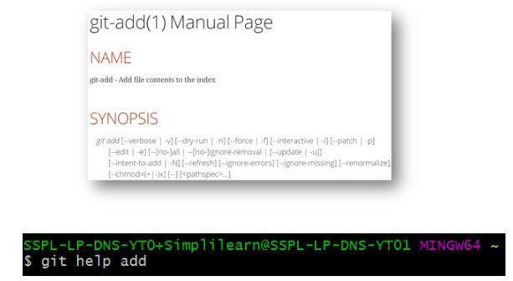
Git Basics
Git Help: Get help on any Git command.
Command: git help <command>
Example: Use git help add to learn more about the git add command.

